Slide 1



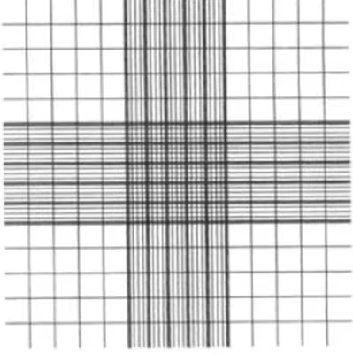
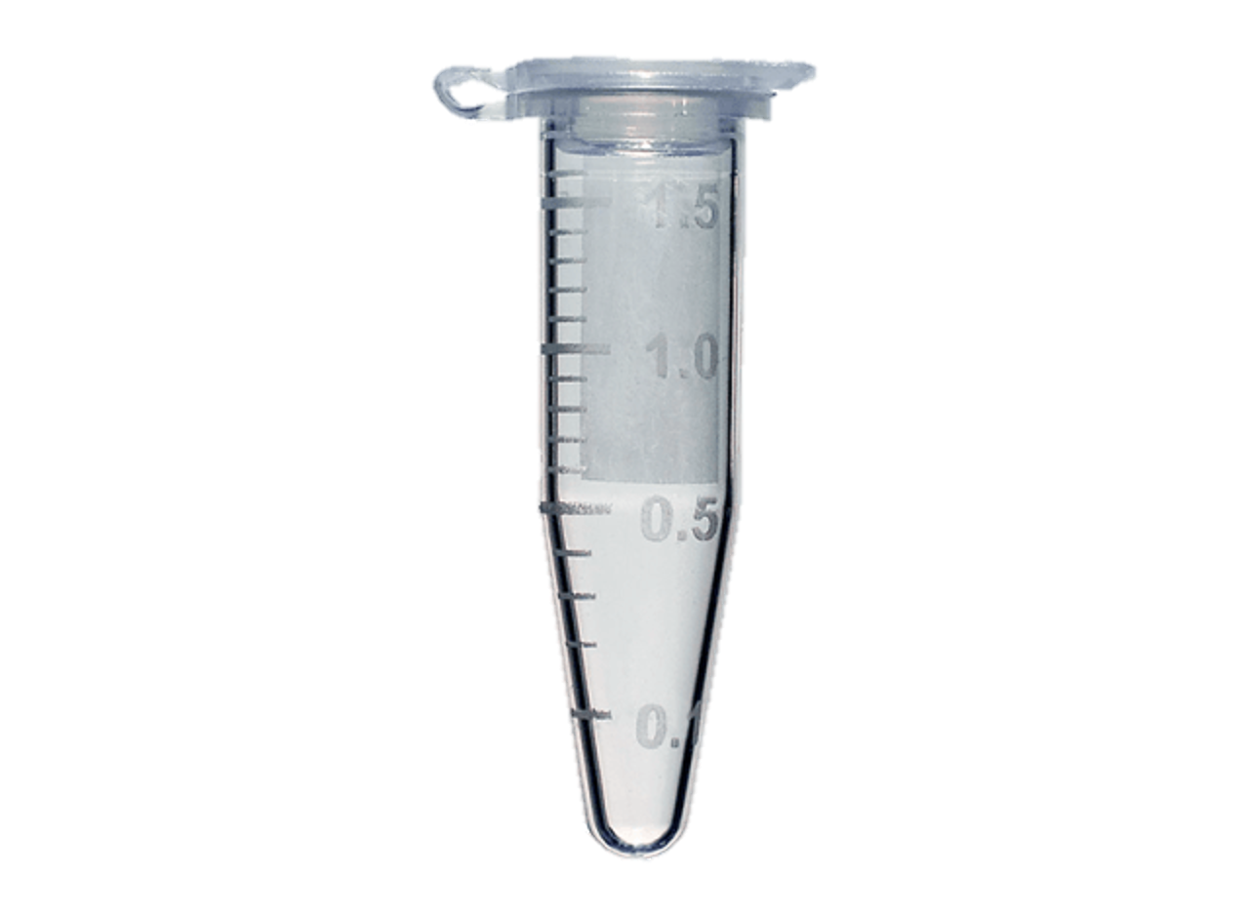
Impacts of temperature on immune response in Hemigrapsus oregonensis
Research Question: How does temperature affect immune response in H. oregonensis? (measured through haemocyte concentration and stress assays)
Alternative Hypothesis: Higher temperatures will result in increased stress levels and decreased haemocyte concentrations in Hemigrapsus oregonensis when exposed to pathogens.
27˚C
13˚C
* 6
* 6
+
weighing
27˚C
13˚C
* 6
Control Tank
1 mortality in the Mud+13˚C treatment (5/6/2025)
1 mortality in the Mud+27˚C treatment (5/13/2025)
Methods:
We placed 6 crabs in three different treatments: Mud + 27˚C, Mud + 13˚C, and 27˚C, with oyster-shells. We performed righting time, Resazurin assay, haemolymph glucose, triglyceride, BCA protein, and lactate. Haemocyte concentrations were counted with a hemocytometer.
Notes:
148 mL of 23-25 ppt saltwater was mixed with 333 uL of resazurin solution, 150 uL of DMSO, and 1.5 mL of antibiotic solution to create 150 mL of resazurin working solution. Crabs from each treatment were put into 35 mL of resazurin solution. Every 30 minutes for 90 minutes 200 uL was placed in a plate which was then ran in a plate reader at excitation 530 and emission 590 to obtain fluorescence values.

Slide 2
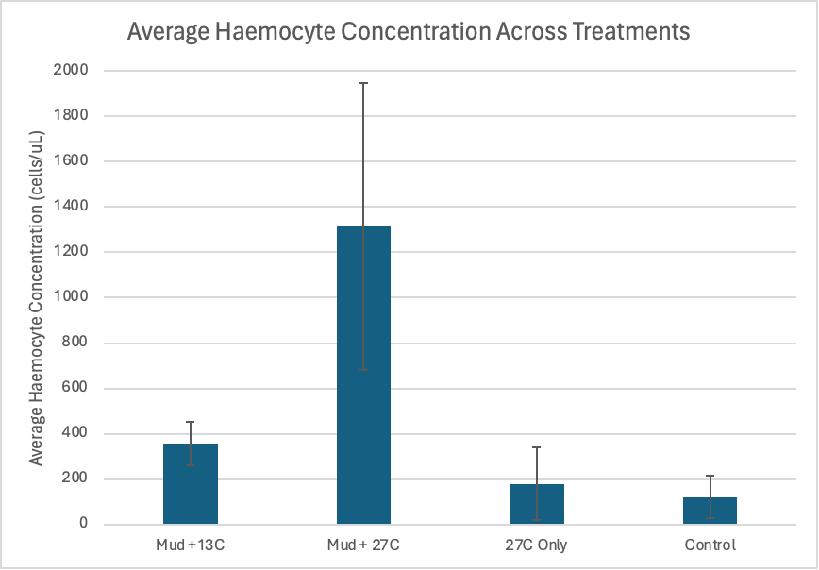
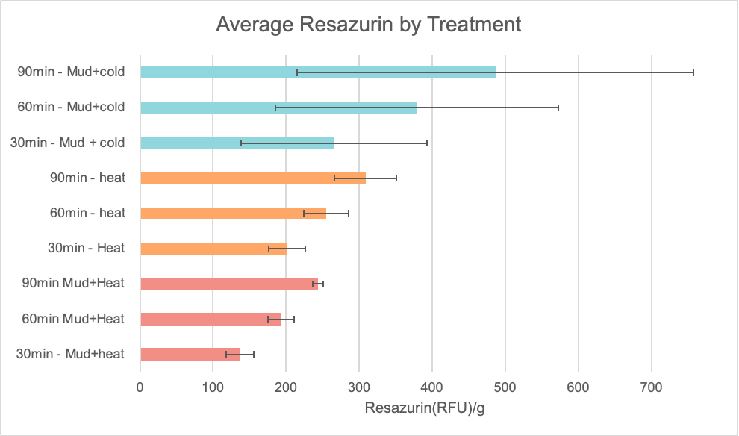
Preliminary Results for Week One:
Summary of Analysis Mindset:
We will analyze and compare data pertaining to stress levels and immune response. We hope to draw connections between organism stress and their immune response. We will analyse heat and mud separately, to hopefully determine their individual effects before analyzing the combined data for all four treatments.
Data Analysis Methods:
Using excel, the data will be averaged for each treatment and the standard deviations will be calculated. Bar graphs will be created to visualize the information, making comparison easier. The final numbers will be compared to the original hypothesis, where it will be determined if we accept or reject the hypothesis.
Notes:
148 mL of 23-25 ppt saltwater was mixed with 333 uL of resazurin solution, 150 uL of DMSO, and 1.5 mL of antibiotic solution to create 150 mL of resazurin working solution. Crabs from each treatment were put into 35 mL of resazurin solution. Every 30 minutes for 90 minutes 200 uL was placed in a plate which was then ran in a plate reader at excitation 530 and emission 590 to obtain fluorescence values.
Resazurin - normalized by weight (n=2) and then averaged per treatment - can be seen here for our first week results. We see high oxygen consumption for the mud and cold treatment, with the lowest levels of oxygen consumption being for our heat and mud treatment. The respiration changes between 30, 60, and 90 minutes are consistent across the board Less respiration is possibly due to heat affecting breathing rate

Slide 3
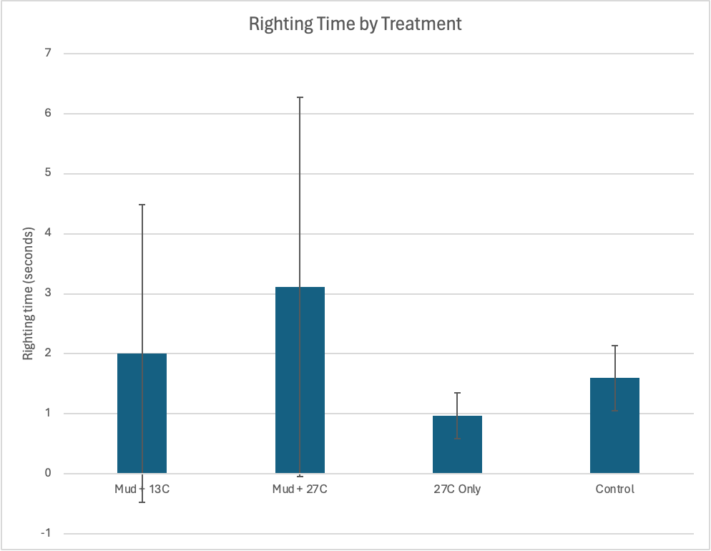
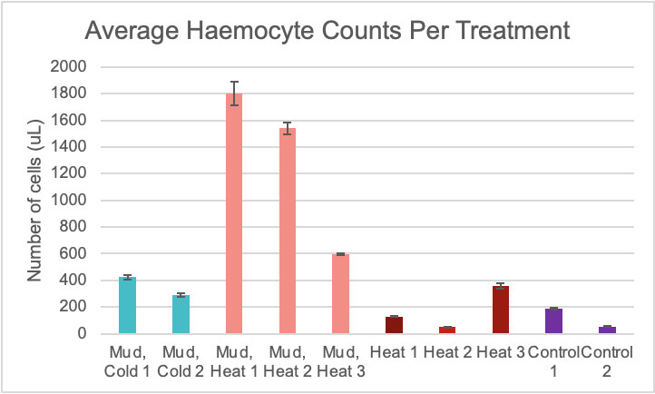
Additional Information:

Slide 4
Sub-Alternative Hypothesis
Under heat-stress conditions…
Righting time
Glucose
Lactate
Osmolarity
Oxygen consumption
INCREASE
compared to control conditions.
Notes:
Higher levels of glucose in crabs can indicate normal and thermal stress, due to excess Crustacean hyperglycemic hormones (CHHs) being released.

Slide 5
Sub-Alternative Hypothesis
Under heat-stress conditions…
BCA Protein
Triglycerides
Haemocyte concentration
DECREASE
compared to control conditions.
Notes:
Higher levels of glucose in crabs can indicate normal and thermal stress, due to excess Crustacean hyperglycemic hormones (CHHs) being released.

